Slide 1
Illinois Higher Education
FY 2017 Budget Recommendations
IBHE Board Presentation
December 1, 2015

Slide 2
IBHE’s FY17 Budget Recommendation
Board of Higher Education Act (110 ILCS 205) requires IBHE to submit budget recommendations to the Governor & the General Assembly.
Legislative FY 17 Budget forms distributed.
Today, Meeting of Governor and Legislative Leaders
Gov’s FY17 Budget Address – Feb. 17, 2016
IBHE to meet again prior to March 1, 2016?

Slide 3
Current Situation – FY 16 Budget Issues
No FY 16 budget for Higher Education (Map, Ops, Grants)
Moody’s cited expected state funding cuts and budget uncertainty as factors for downgrading
Comptroller cites $8.5 billion backlog by Jan. 2016 with likely delays in monthly $560 million pension payment (Nov/Dec)
Start of FY 16, $286 million, or 20%, left unpaid from FY 15
Serious concern of impending FY 16 carryover past June 30 into FY 17
2016 funding proposals for Universities range $280 million/25%
Capital projects still on hold due to no budget

Slide 4
FY 17 Outlook & Priorities
Support goals of the Public Agenda & 60 X 2025 Increase Educational Attainment, Ensure College Affordability, Increase # of Quality Degrees, Integrate Educational, Research and Innovation Assets
View core funding for public colleges and universities as an investment
Support funding for need based financial aid
Advocate for a state Capital Bill (Deferred Maintenance/Renewal)
Active discussion on Efficiency and Effectiveness Initiatives Performance Based Funding, Budgeting For Results, IL Performance Reporting System metrics, Grant Accountability and Transparency Act (GATA), and reforms curtailing unfunded mandates.

Slide 5
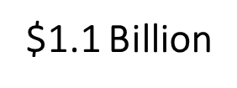
State support for Higher Education programs decreased $1.1 billion since 2000 ~ putting greater reliance on Income Funds and local resources

Slide 6
Between FY 2000 to FY 2015 (Adjusting to FY 15 dollars)
Public Universities State general funds support as percentage of overall revenues declined 72% to 39% while tuition revenues increased 28% to 61% with weighted tuition & fee rates rising by 140%.
Community Colleges State general funds support as percentage of overall revenues declined 28% to 15% while tuition revenues increased 27% to 44% with weighted tuition & fee rates rising by 73%.
MAP Program While State general funds appropriations increased 9%, after adjusting for inflation, it reflects a 22% decrease. In FY 2015, there were 6% less student awards with the maximum award only covering about a quarter of the average tuition & fees (both 2-yr & 4-yr) compared to 100% in 2000.

Slide 7
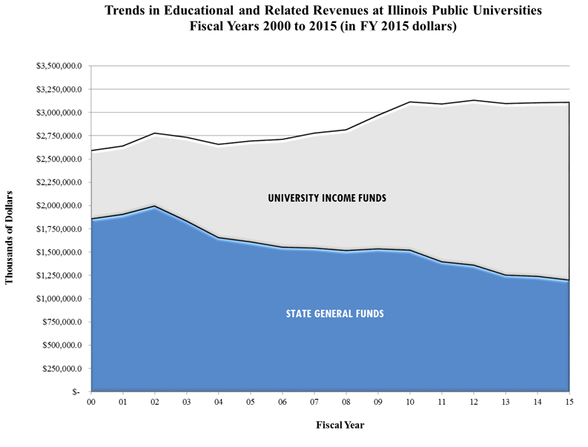
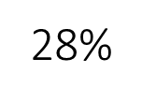
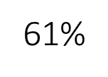
39%

Slide 8
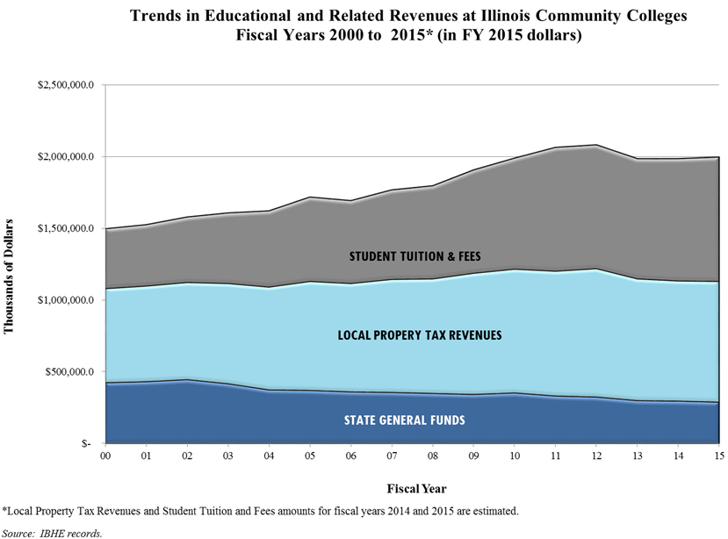
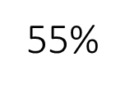
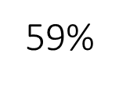

Slide 9
Investing in Higher Education
Cornerstone to state’s economy & our standard of living – 150 years investment in public institutions ~ while reducing pressure on state budgets in health care, public assistance, and criminal justice costs.
Investment drives regional and state growth employing 61,000 with $6.9 billion in university spending, generating $28 billion to the economy
Community Colleges spending lead to $3.1 billion and nearly 51,000 jobs in FY 12.
Closing college attainment gap and strengthening workforce earnings depends on investment in public higher education.
Close income inequality, 2.9 million of the 6.6 million new jobs since 2008 pay over $53k, 97% of these good jobs went to degree holders.

Slide 10
Major Highlights for FY 2017 (General Funds)
Public Universities - $1.2 billion, same as FY 16 IBHE level, includes .5% or $6.1 million in Performance Funding.
Illinois Community College Board - $294.4 million, similar level to IBHE FY 16 level & Adm.’s proposed budget, and $51.3 million for Adult Education and Postsecondary Career and Technical Education program.
Monetary Award Program (MAP) - $423.3 million, $50 million more over FY 15 original appropriation and same as FY 16 IBHE recommended level.

Slide 11
Major Highlights for FY 2017 (General Funds)
Illinois Student Assistance Commission – $20.7 million, or $2.8 million over IBHE FY 16 level for operational support for state grant and scholarship programs and outreach programs largely to replace lost federal funds.
Illinois Mathematics and Science Academy - $18.6 million, or $183,500 above FY 15 for $1.5 million in projects with health, life & safety concerns.
State University Retirement System - $1.7 billion, $70.5 million, over the Fiscal Year 2016 certified amount from all funds.

Slide 12
Major Highlights for FY 2017 (General Funds)
State Universities Civil Service System - $1.2 million, same level as FY 15 adjusted level for operations.
Illinois Board of Higher Education - $10.8 million, same level as FY 15 adjusted appropriation level, $3.06 million for operations and $7.7 million for grants and special initiatives, and reestablishes the Higher Education Cooperation Act (HECA) program.
Higher Education Capital Program - $2.5 billion for capital projects, capital renewal projects ($350 m), and escalation & emergencies ($48 m) to address deferred maintenance needs. Virtually the same listing as last year with no new capital $ since FY 2010.

Slide 13
Budget Predictability is Required to Get Back on Track

Slide 14
Maintain Foundation Level for Public Universities

Slide 15
Stagnant Growth for Community Colleges

Slide 16
Illinois Higher Education Compact
Call for predictability & stability for State-supported operations, grants and capital programs to better enable strategic budget planning for all of higher education systems and programs that improves affordability, effectiveness, student success, and economic growth in Illinois.
Demonstration of efficiency and effectiveness is tied to support for public investment in higher education.
Compact partnership to be comprised of leaders of higher education, executive and legislative branches and key stakeholder groups in developing strategies for more predictable state investment over a 3-year period.

Slide 17
Questions/Discussion?
Kevin Schoeben
Deputy Director
Fiscal Affairs and Budgeting
Illinois Board of Higher Education
Schoeben@IBHE.org
217-557-7353

